Slide 1
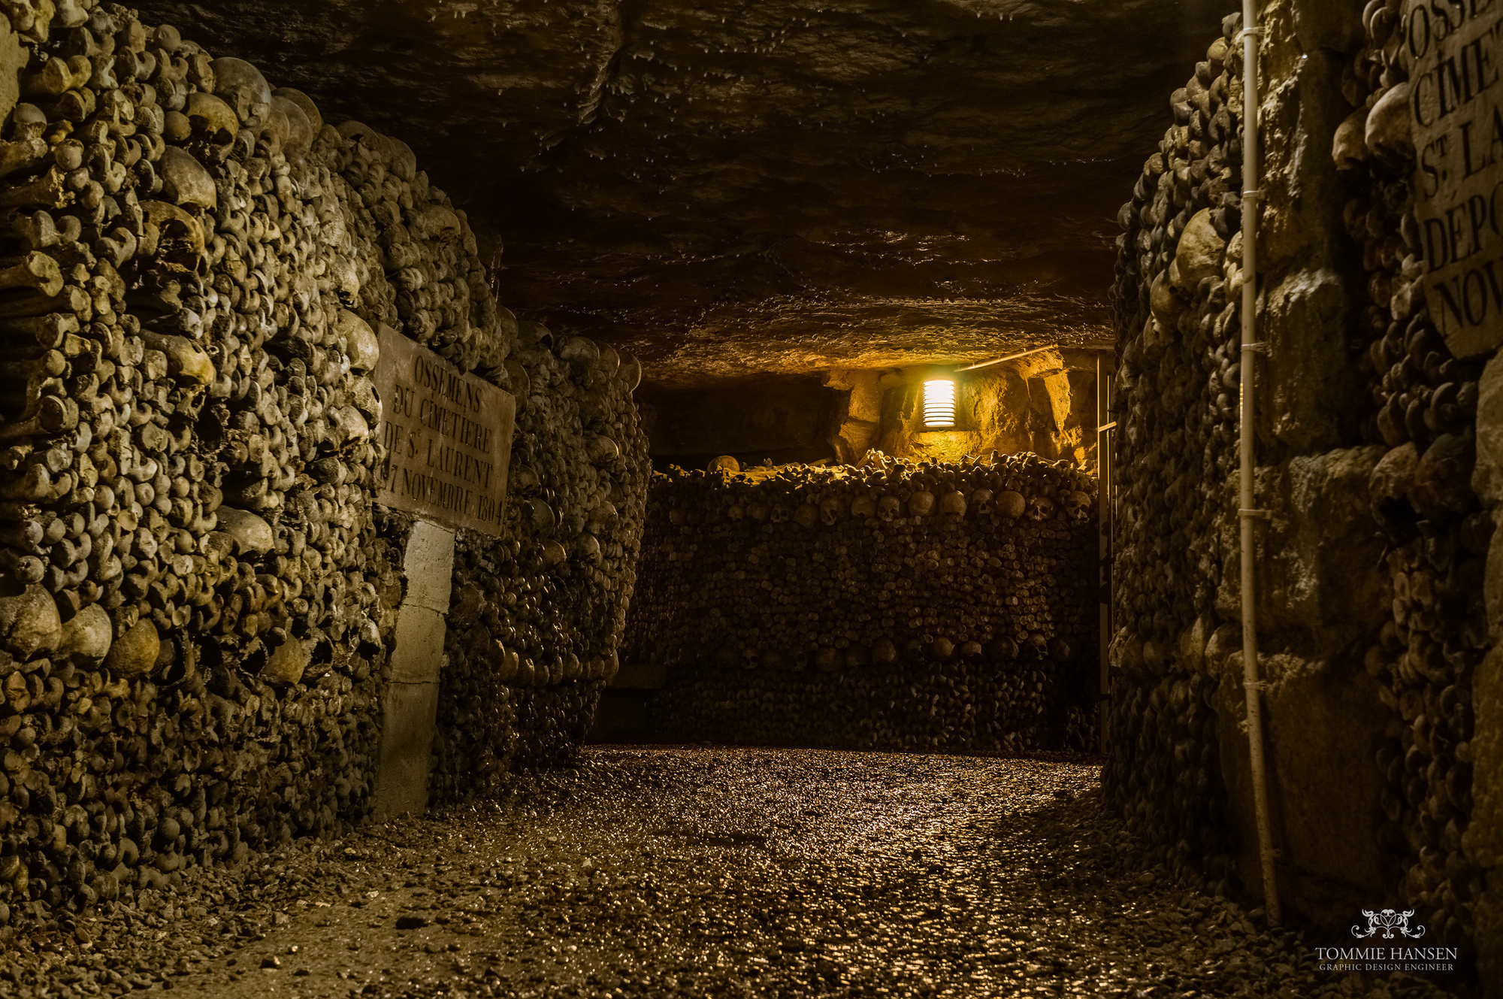


Vive les Catacombs
TRapped in the paris catacombs unravel the dark story of your ancestors and the evil that lies within.

Slide 2

Introduction
Set in the Paris catacombs
Player encounters enemies puzzles and traps
Unravel the mysteries of the catacombs
Gameplay through two perspectives

Slide 3
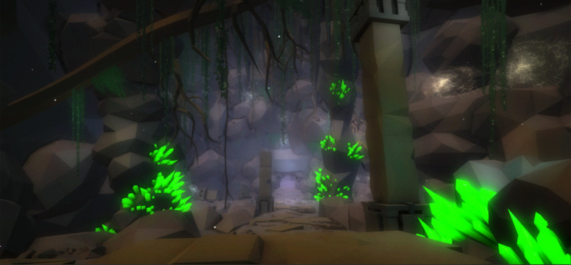
What does the player do?
Melee combat
Solve puzzles
View two worlds
Take control of your ghost character
Possession
Interact with the spirit world
Manage sanity meter
Timed escape sequences

Slide 4
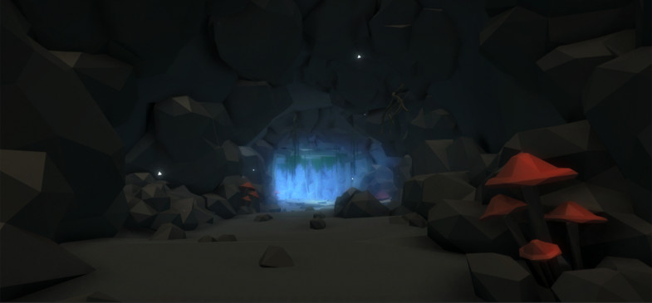
Summary of key facts
Multi-platform
Horror exploration
Release date Q2 2022
Pay to play plus future DLC
Singleplayer
15 Hours of gameplay
High replayability
Exploration with puzzles and horror

Slide 5
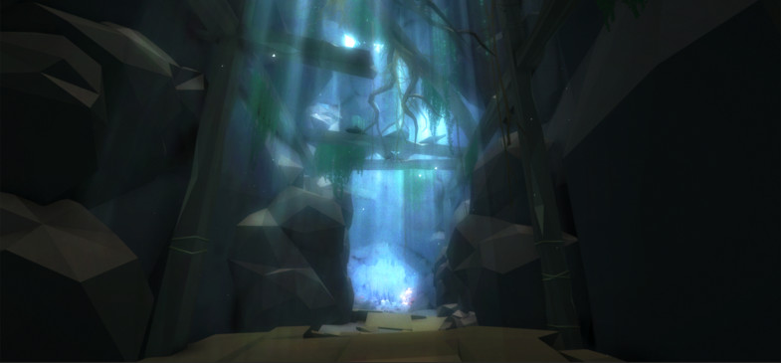
The World
Dark mysterious tunnels
Procedurally generated
Dark / Light

Slide 6
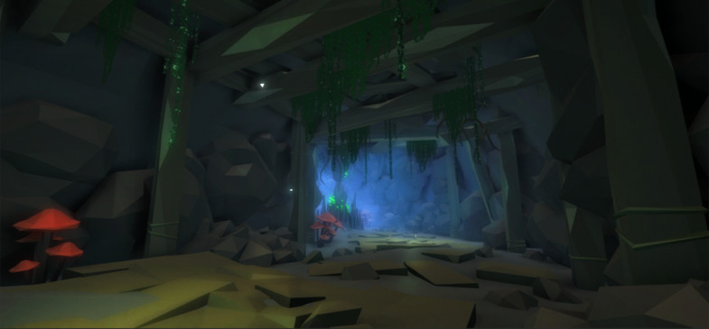
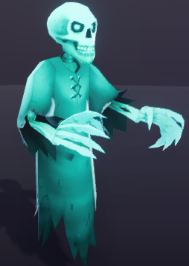
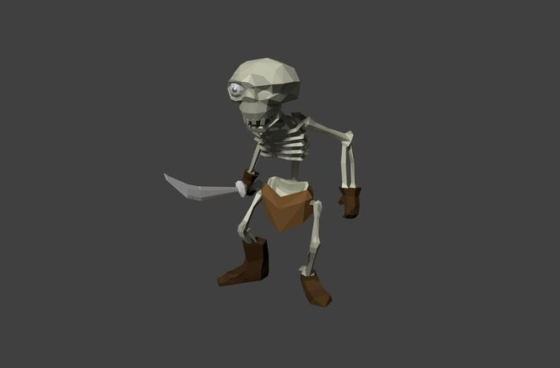
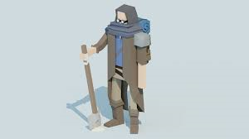
Art work
Low poly
Dark theme

Slide 7


Any Questions?
Thank you

